Slide 1

Kaduna State, NIGERIA
Infrastructure Transparency Index (ITI)
Results presentation 2026

Slide 2

Content
Introduction
Methodology
Results
Conclusions and recommedations
Annex

Slide 3
1. Introduction

Slide 4
The Infrastructure Transparency Index (ITI) is a CoST instrument that measures the levels of transparency and quality of processes related to public infrastructure at the national or subnational level. Designed collaboratively and based on good practices and international lessons learned, with the objective of providing quality information that serves to promote transparency and improve the management of public infrastructure.

Slide 5
Transparency for a more effective, inclusive and sustainable public infrastructure.
Notes:
The ITI does not see transparency as an end, but as a means to something greater: effective, inclusive and sustainable infrastructure.

Slide 6

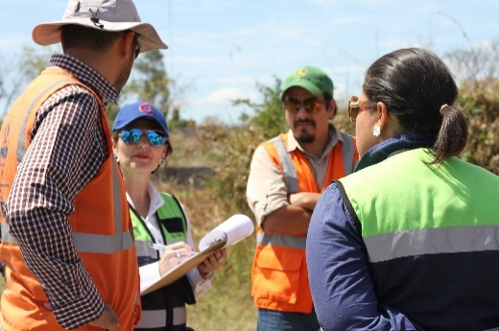
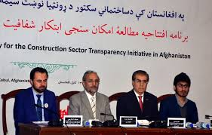
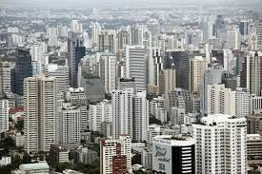
Dimensions
Enabling environment
Capabilities and processes
Citizen participation
Information disclosure
Notes:
To bring out in the notes: The 30% figure actually underestimates the value of CoST, because you end up with the wrong quality of infrastructure (which is a huge cost) [Hamish]

Slide 7
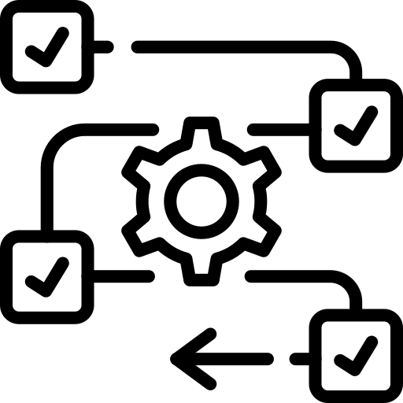



Dimensions
Enabling environment
Capabilities and processes
Access to public information regulatory framework
Transparency standards in public infrastructure
National digital information tools
Basic transparency knowledge
Digital capacities
Procedures to disclose information
Enablers and barriers to disclose information
Control over infrastructure projects disclosure
Citizen participation
Information disclosure
Participation opportunities
Use of information by citizens
Project identification
Project preparation
Execution and supervision contracts procurement
Execution and supervision contract implementation

Slide 8
Structure
ITI Score
Dimensions
Variables
Sub-variables
Indicators

Slide 9
Output and outcomes
The ITI offers transparency scores for a comprehensive set of indicators based on a 100-point scale that contribute to:
Raise awareness about the strengths and weaknesses of transparency in public infrastructure.
Guide public leaders, at centralized and decentralized levels, to strengthen transparency and accountability in the sector.
Develop a collaborative agenda to raise transparency standards that contribute to a more effective, inclusive, and sustainable infrastructure.

Slide 10
2. Methodology

Slide 11
Implementation process
Preparation
Evaluation
Processing
Reports

Slide 12


Evaluation
Data collection methods
Enabling environment
Capacities and processes
Citizen participation
Information disclosure
Object of evaluation
National and sub-national conditions
Procurement entities
Procurement entities
Procurement entities projects
Collection method
Desktop research
Entities survey
Entities survey
Desktop research

Slide 13
Procuring entities
Projects from 2023–2025 were selected to align the evaluation with the current administration’s implementation period.
Only seven (7) entities were identified as implementing agencies during this timeframe. They were all selected for evaluation.
This reflects a deliberate government strategy to centralize infrastructure project execution.
The approach was intended to enhance coordination, ensure consistent delivery, and improve transparency.

Slide 14
 | Entity name | MDA type | OC4IDS sector
1 | Kaduna State Water Corporation -KADSWAC | Agency | Water and waste
2 | Kaduna State Facilities Management Agency -KADFAMA | Agency | Governance
3 | Kaduna State Primary Healthcare Board -KDSPHCB | Agency | Health
4 | Kaduna State Roads Agency -KADRA | Agency | Transport
5 | Ministry of Business, Innovation and Technology -MBIT | Ministry | Education
6 | Ministry of Housing and Urban Development -MHUD | Ministry | Health
7 | Ministry of Public Works and Infrastructure -MPWI | Ministry | Transport
The seven (7) entities represent 100% of Ministries Departments and Agencies (MDAs) with construction projects for the period 2023-2025.

Slide 15
Projects sample
The projects database was compiled by Kaduna State Public Procurement Authority (KADPPA) using its registries to identify infrastructure projects contracted between 2023 and 2025 across public entities.
Selection focused on construction projects that create new infrastructure and deliver public value.
Renovation-only projects, typically smaller and lower in budget, were excluded.
Only projects with budgets above USD 250,000 were considered to ensure significant impact.

Slide 16
Projects sample Contd…
Only projects with at least 6 months since their initiation were considered, to be able to evaluate their construction stage.
The two (2) projects that met the above conditions with highest budget were selected.
From the remaining projects that meet the above conditions, two (2) more were randomly selected.
Entities that did not have four (4) projects that meet all the above criteria had a lower amount of projects to evaluate.

Slide 17
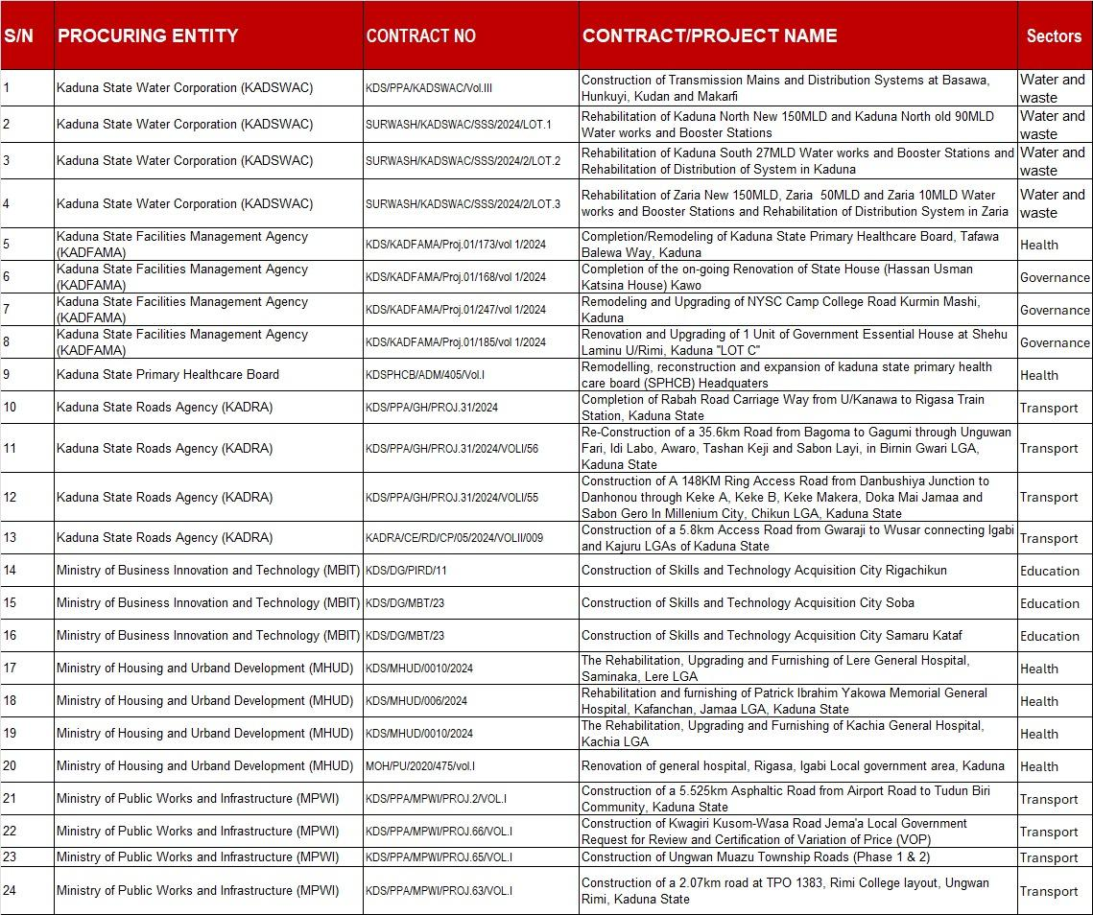

Slide 18
Evaluation
Entity interaction protocol
On 17 March 2026, the ITI team conducted advocacy visits to selected MDAs to collect signed commitment cards and deliver invitations to the ITI Commissioning Workshop.
On 18 March 2026, the hybrid kickoff Commissioning Workshop was held with participating entities and key state stakeholders.
From that date until 9 April 2026, one-to-one engagement meetings were held, including confirmation of designated survey focal persons and guidance on completing the survey and providing evidence.
Entities submitted questionnaire responses, with follow-ups to clarify gaps, request additional information where necessary, and confirm completion of the survey.

Slide 19
Entity interaction protocol
For entities that did not submit the questionnaire, follow-ups were conducted through calls and messages on at least five occasions.
Entities generally cooperated by prioritizing the survey, in line with the provided timeline for completion and submission.
The CoST Secretariat also supported follow-up efforts to encourage cooperation with the evaluators.
All entities completed their survey and returned it to the assigned Evaluators directly.

Slide 20
3. Results

Slide 21
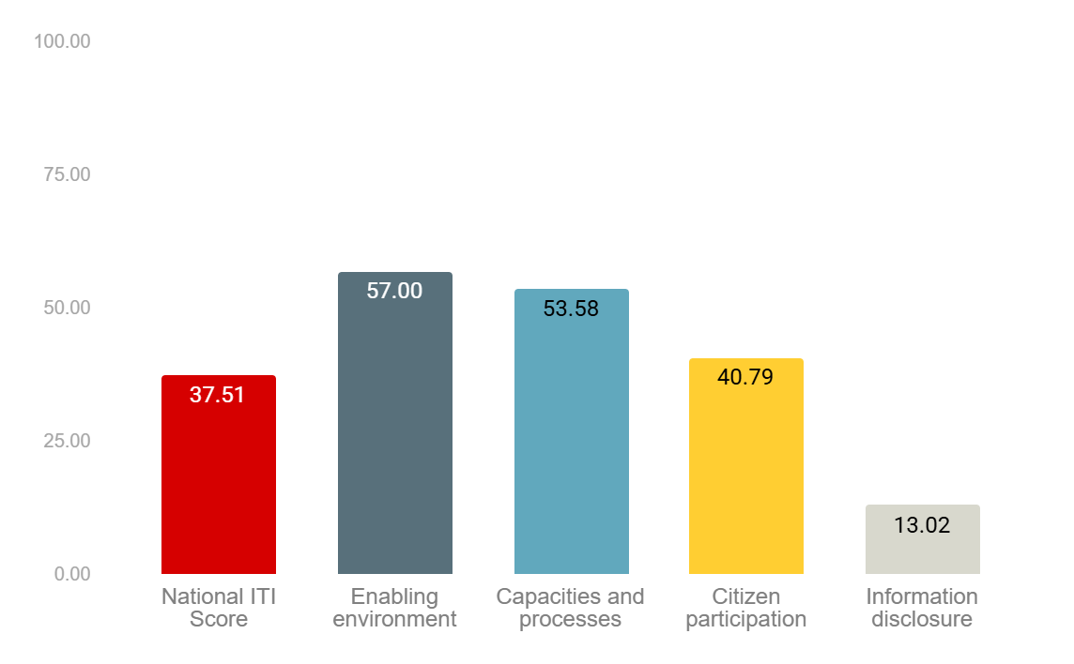
National or Sub-national ITI
Institutional and operational foundations for transparency are relatively strong.
Foundations for effective transparency and accountability are in place.
However, information publication is weak, when projects are evaluated through their life cycle.
And there are important opportunities for citizens to engage with infrastructure projects to enhance accountability and responsiveness.

Slide 22
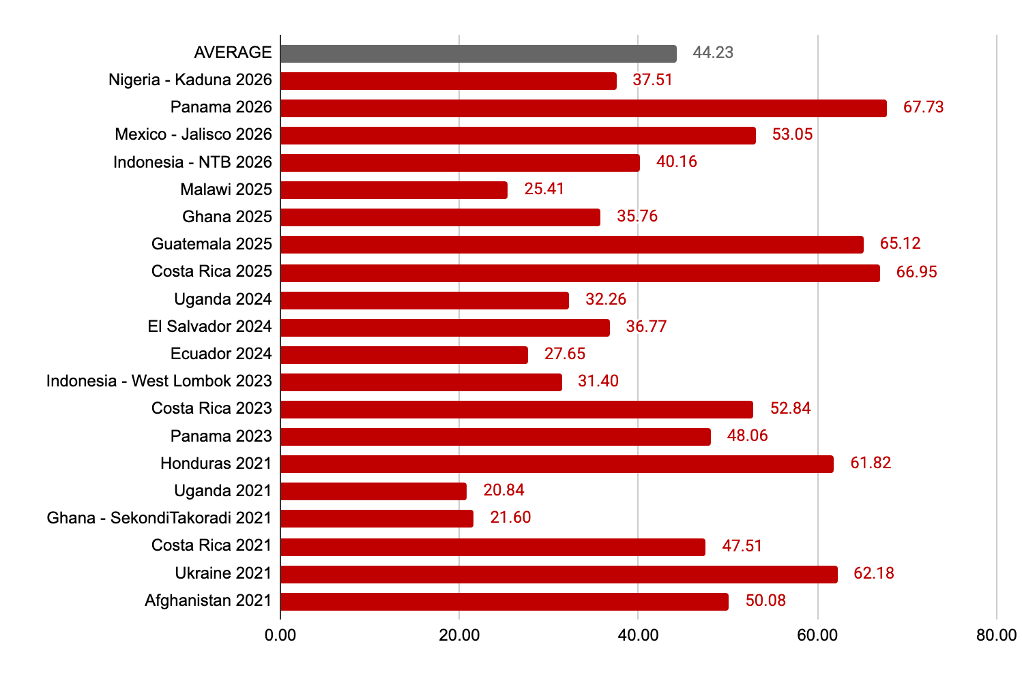
International comparison
While international leaders approach 65–70%, Kaduna remains below average—highlighting a clear competitiveness and transparency gap.
Kaduna demonstrates stronger performance than its African comparators, positioning it as an emerging mid-tier performer.
However, Kaduna’s competitiveness could be affected by the wide information gap.

Slide 23
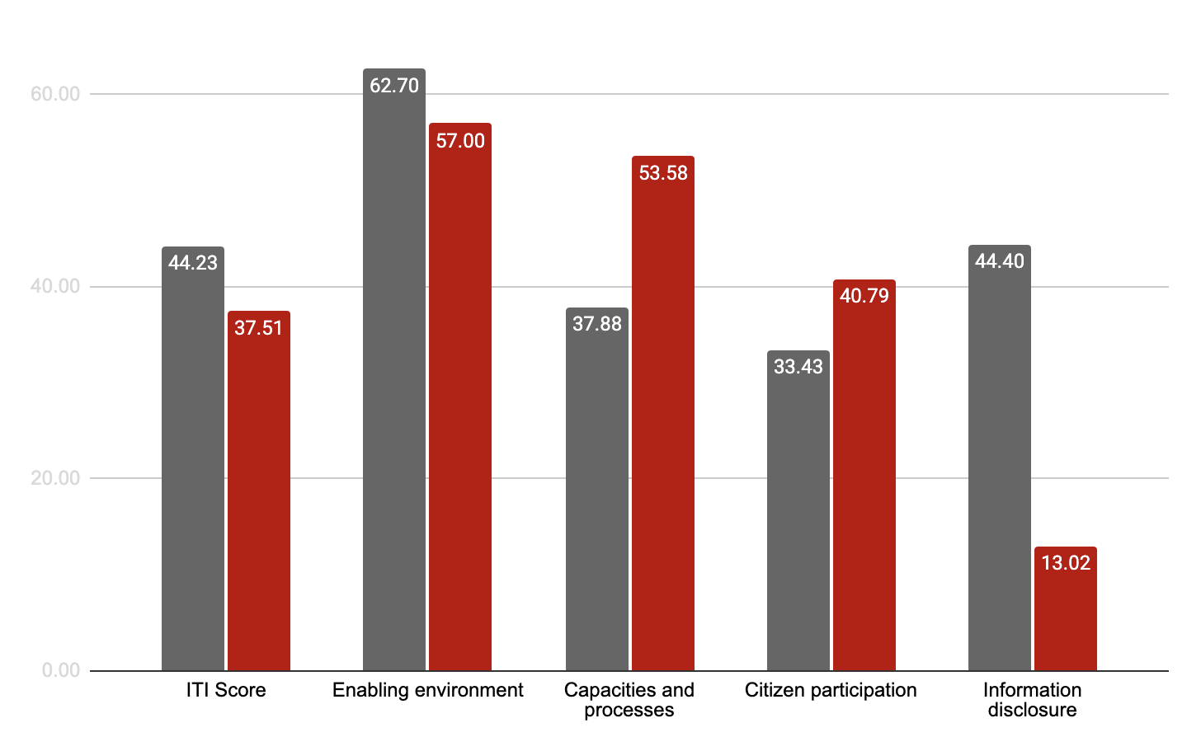

International comparison: Dimensions
Strong institutional base observed in capacities and processes.
Growing citizen engagement.
Major transparency / data publication gap.

Slide 24
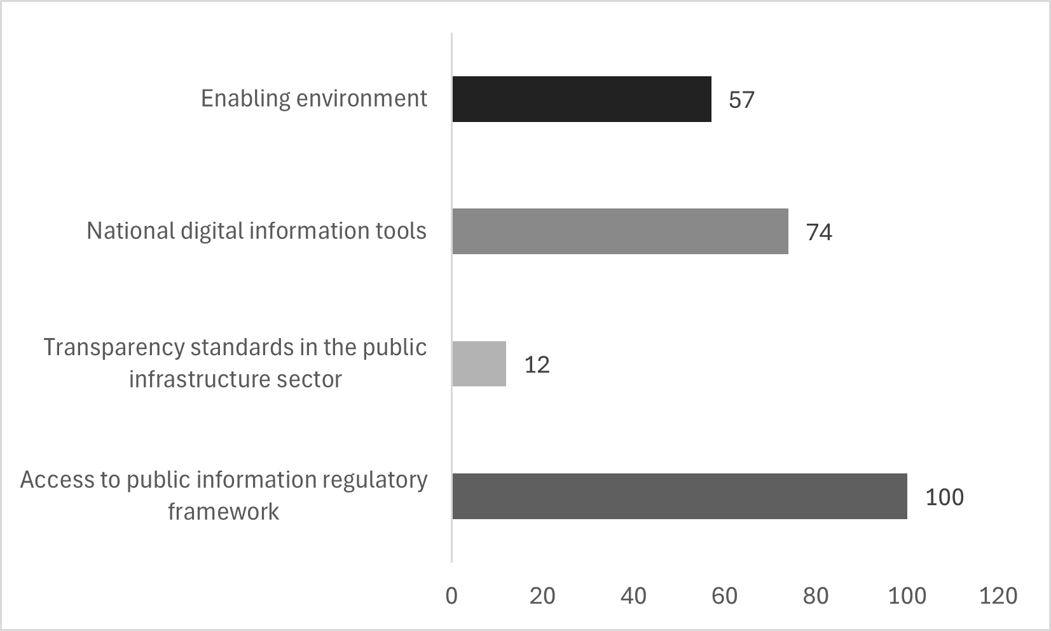
Enabling environment
Strong legal framework
Very weak sector-specific transparency standards
Open sector policies with –practice gap
Graph with dimension 1 and its 3 sub-variables

Slide 25
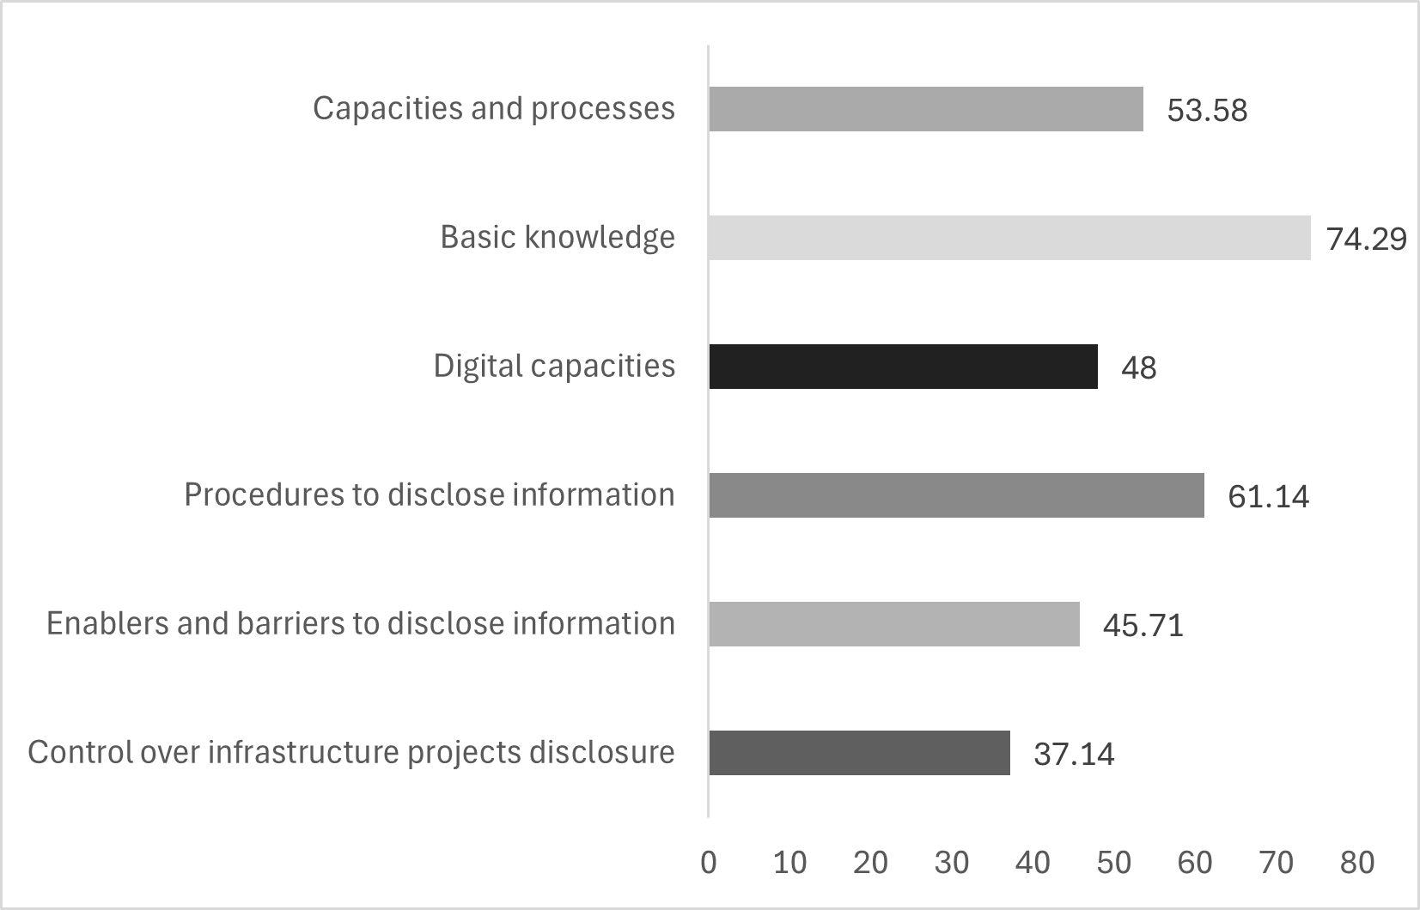
Capacities and processes
Strong foundational knowledge on transparency
Moderate procedural systems
Weak digital capacity
Weak knowledge on the amount and quality of data that is published
Graph with dimension 2 and its 5 sub-variables

Slide 26
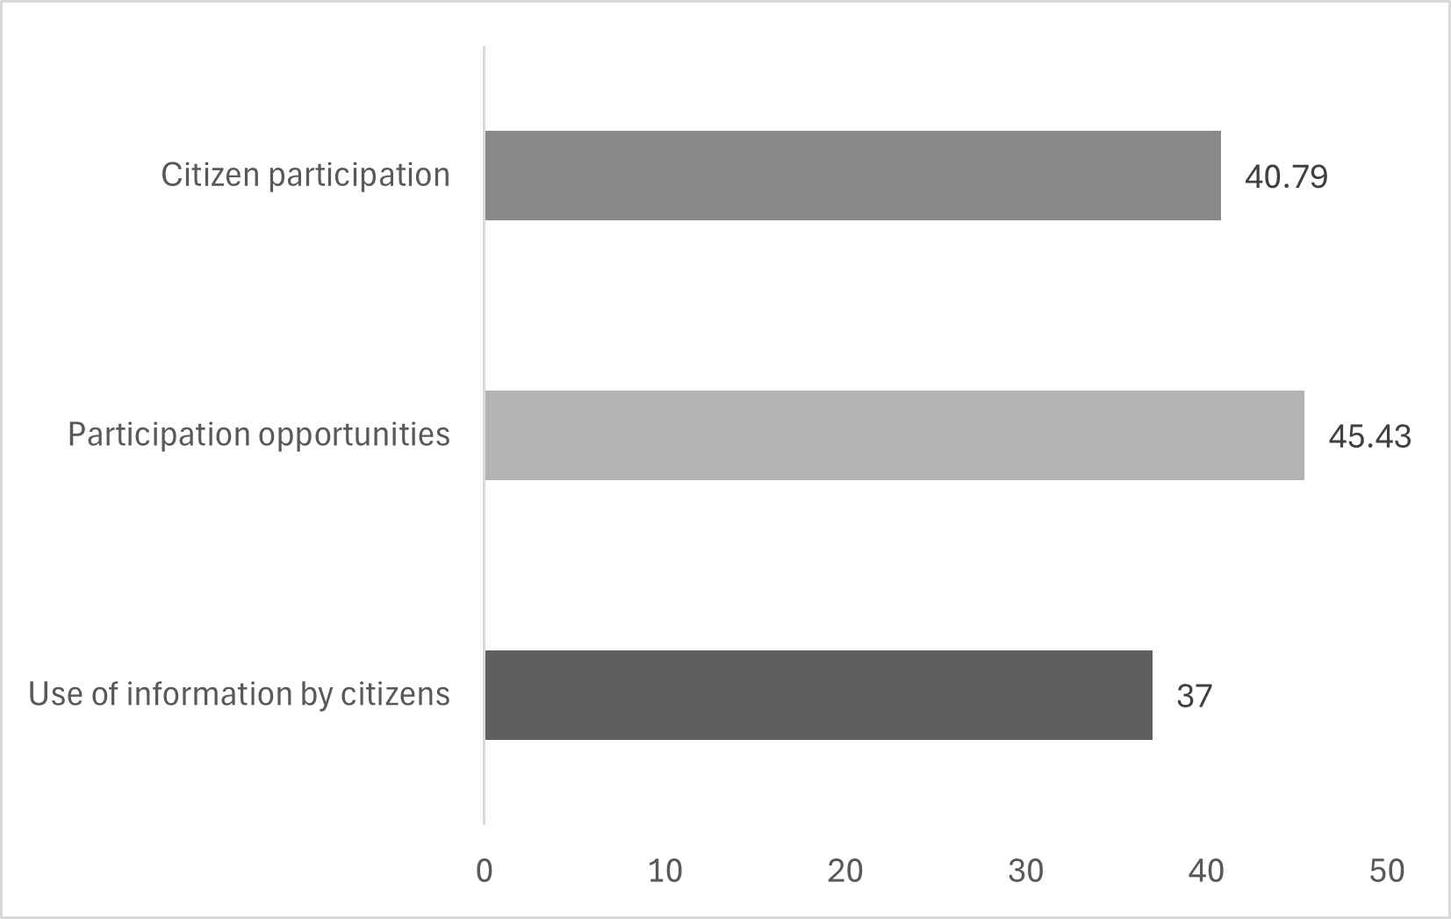
Citizen participation
Moderate engagement levels
Opportunities exist but underutilized
Low citizen usage of information
Graph with dimension 3 and its 2 sub-variables

Slide 27
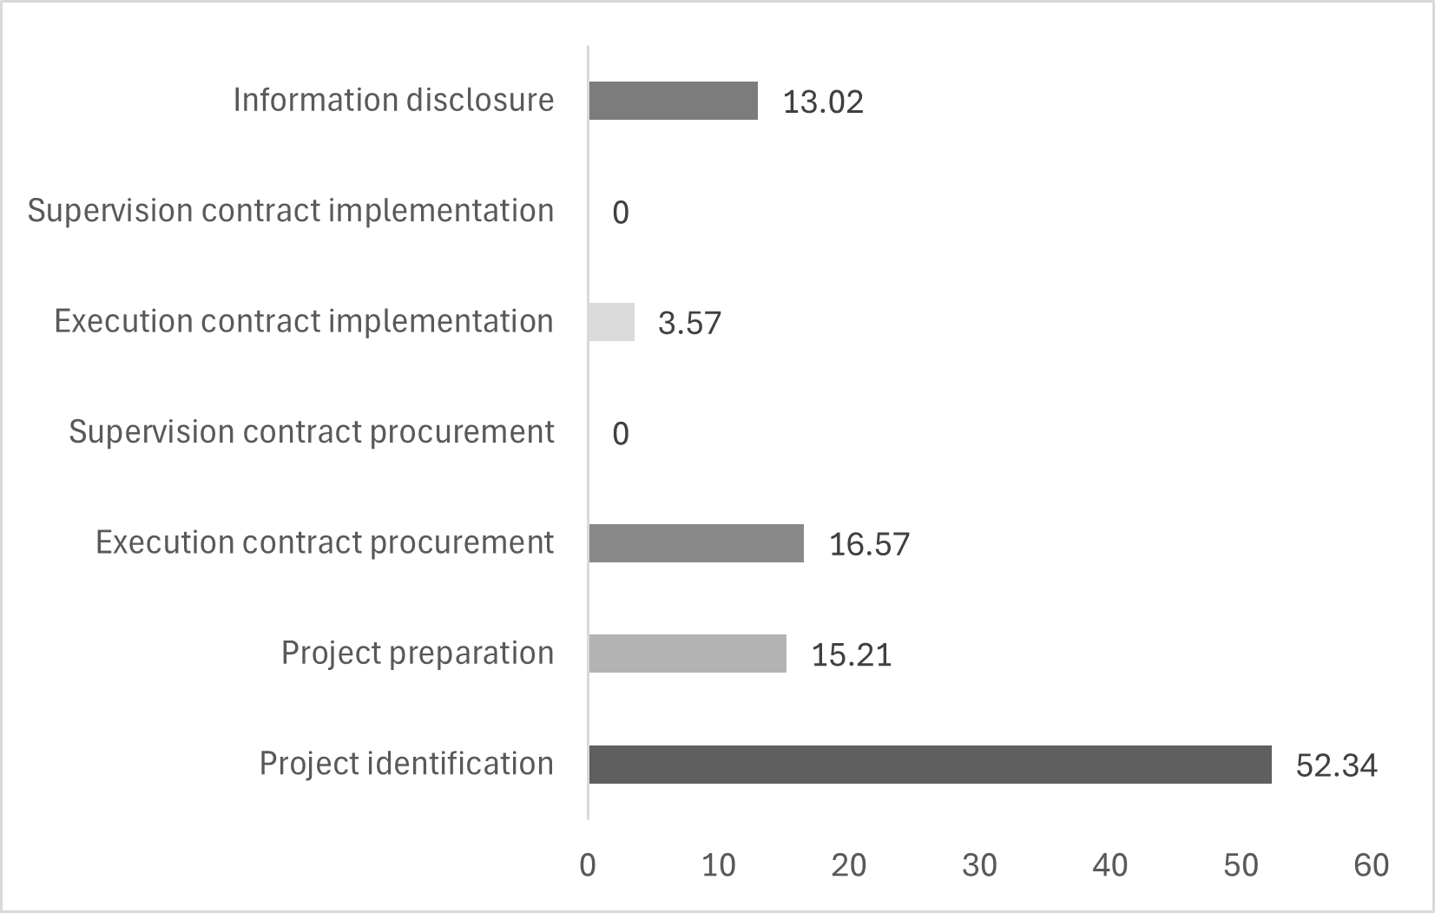
Information disclosure
Very weak overall disclosure
Strong at project identification only
Near-zero contract transparency
Weak contract / project management standards.
Graph with dimension 4 and its 6 sub-variables

Slide 28
3.1 Results by procuring entities

Slide 29
ITI Entities: Ranking
Ranking | Entity name | ITI Score | Capabilities and processes | Citizen participation | Information disclosure
1 | Kaduna State Water Corporation -KADSWAC | 40.79 | 52.60 | 60.80 | 17.95
2 | Kaduna State Facilities Management Agency -KADFAMA | 42.81 | 69.63 | 47.55 | 16.38
3 | Kaduna State Primary Healthcare Board -KDSPHCB | 39.30 | 69.57 | 43.95 | 9.90
4 | Kaduna State Roads Agency -KADRA | 45.94 | 79.82 | 54.95 | 10.68
5 | Ministry of Business, Innovation and Technology -MBIT | 22.73 | 33.94 | 27.90 | 9.70
6 | Ministry of Housing and Urband Development -MHUD | 22.28 | 33.08 | 20.85 | 13.71
7 | Ministry of Public Works and Infrastructure -MPWI | 25.28 | 36.44 | 29.55 | 12.85
Average of all entities* |  | 34.02 | 53.5 | 40.79 | 13.02
* This is the average score of all evaluated entities considering their performance on dimensions 2, 3 and 4. It does not include dimension 1, as this last one evaluates overall national and subnational conditions, instead of entities.

Slide 30
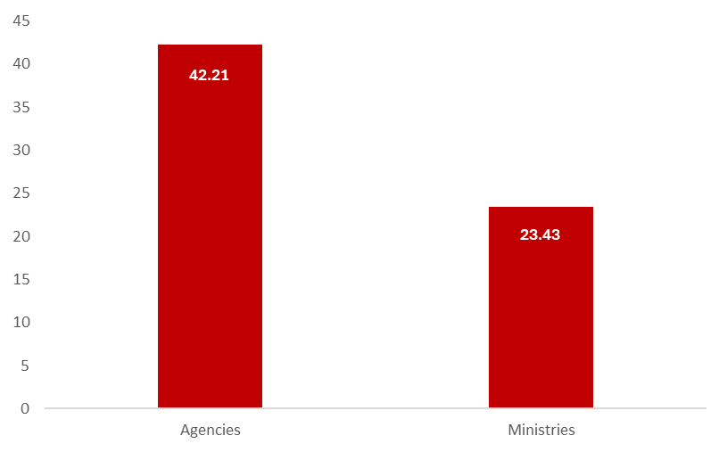
ITI Entities: Differences according to “type”
Agencies outperform ministries
Large performance gap (~2x) exist between Ministries and Agencies

Slide 31
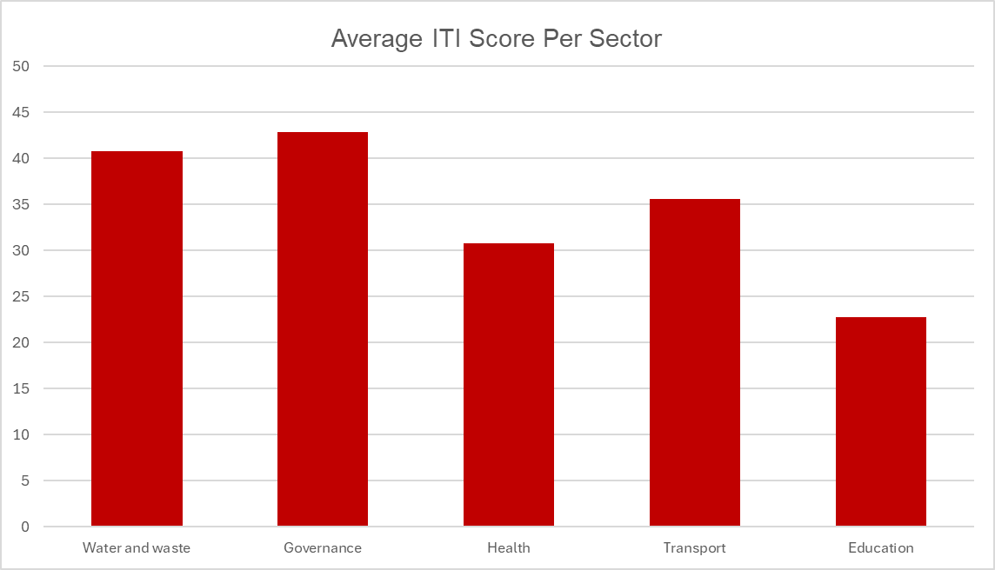





ITI Entities: Differences according to “sector”
Sectoral variance is pronounced – ITI scores range widely (~22–41), indicating uneven transparency performance across sectors.
Water and waste, as well as Governance (government accommodations and buildings,) exhibit higher average ITI scores, suggesting relatively stronger disclosure and processes.

Slide 32
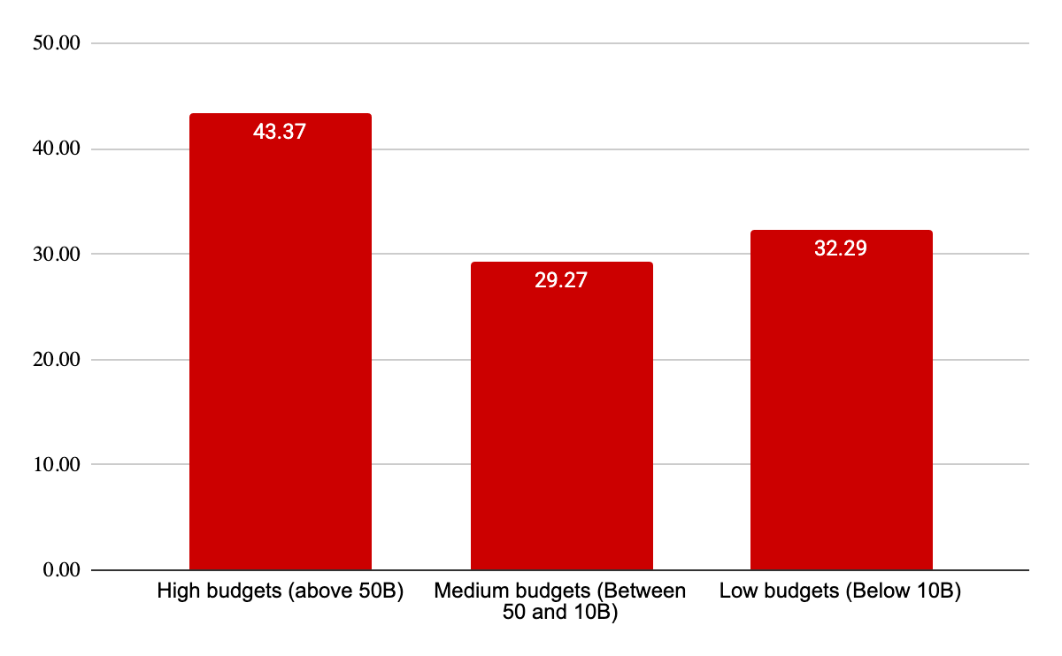
ITI Entities: Differences according to “budget”
Entities in the high-budget category record the highest ITI average score. This suggests that higher financial capacity is associated with; better institutional structures and stronger compliance with transparency standards.
Entities with medium and low budgets have similar ITI scores. Suggesting their capacities, processes, and supporting systems are less developed than high-budget entities.

Slide 33
4. Conclusions and recommendations

Slide 34
Conclusion
The slides above present the ITI assessment for Kaduna State 2023 - 2025 period using the CoST framework, covering;
4 Core Dimensions: Enabling Environment, Capacities and Processes, Citizen Participation and Information Disclosure
Coverage here focus on construction projects with measurable public value.
The methodology aligns with CoST standards, ensuring:
High credibility of results
Strong comparability across entities
Policy relevance for state level reform

Slide 35
Conclusion - ENABLING ENVIRONMENT
From the evidence, we have seen that Kaduna State has built a solid policy and regulatory foundation for transparency.
Presence of general regulatory frameworks (procurement laws, transparency laws, OGP commitments)
Transparency standards in practice show progress, as there is some compliance with OC4IDS and open data in KADPPA Portal, but the frameworks to support these standards do not exist.
Centralized information portal can improve on: missing data, coverage (not all projects included), update on real time data.

Slide 36
Conclusion - CAPACITIES AND PROCESSES
There is a disconnect between knowledge and execution
Entities surveyed shows basic knowledge of transparency concepts.
Existence of procedures (mostly informal) impact on weak publication performance based on the OC4IDS: Initiation stage is showing some progress; preparation and execution contract procurement is showing little progress; and supervision and implementation show no progress.
Mixed digital capacities that shows existence of operational workflows (48 pts). Some entities show problems in accessing and using information tools to manage their infrastructure projects data.
Entities have limitations in knowing how much infrastructure data they are publishing (37 pts).

Slide 37
Conclusion - CITIZEN PARTICIPATION
Evidence provided from the survey revealed that citizen participation is moderate, but mostly externally driven. It exists but is not fully institutionalized within MDAs.
There is a strong external participation platform (at a high level), enabled through CoST Multi-Stakeholder Group.
Evidence of citizen engagement in budgeting and monitoring through Open Government Partnership (OGP), not streamlined to public infrastructure delivery processes.
Entities indicated that they do not have Grievance Redress Mechanism (GRM) and officials responsible for citizen engagement on infrastructure projects.
Entities may not be properly recording and responding to the citizens information requests.
Entities could engage stronger with CSOs, academia or other actors to make infrastructure information more accessible and understandable to the citizens.

Slide 38
Conclusion - INFORMATION DISCLOSURE
Results revealed that information disclosure is strong but inconsistent.
Open data platforms exist, with OC4IDS standards (KADPPA portal provides a centralized, structured data publication), but with weak compliance.
Publication of project data and visualizations tools are also available as seen on the website, but similarly, with weak compliance.
There is no information on contracts execution.
Entities are failing to disclose information on how they supervise projects.
Entities fail to present valuable data, among others:
Contact information on all their projects.
Information on how the projects impact the environment and settlements.
Type of procurement process that was applied to award the contract.

Slide 39
Conclusion
Kaduna State is an example of subnational transparency reform in Nigeria, particularly in:
Adoption of international standards (efforts focused on the practice)
Centralized transparency systems (underutilized)
Citizen engagement practices (but not properly applied on infrastructure projects)
To reach advanced transparency maturity, the State must move to institutionalize its efforts and require entity-wide accountability.

Slide 40
Recommendations
SHORT-TERM (0–6 MONTHS) The signing and implementation of a Formal Disclosure Mandate (FDM) that covers the standards, the platform, the responsibilities, incentives and sanctions on non-compliance. Training public officials on infrastructure transparency frameworks, portal, good practices, citizens participation. Provide institutional access to hard and software, such as internet, to improve information disclosure across MDAs. Officials from entities responsible for data publication should act on the weekly updates/alerts from the information platform/dashboard to address the quality and completeness of data queries.

Slide 41
Recommendations
 | MEDIUM-TERM (6–12 MONTHS) Establish citizen engagement units or desks at all MDAs. A system of measurable performance indicators should be developed to track transparency efforts. Integrate the “eyes and ears” platform with the information platform. Enable interoperability between the procurement system and the infrastructure disclosure platform, to enhance information publication.

Slide 42
Recommendations
LONG-TERM (1–3 YEARS) Fully digitize infrastructure information management and archiving systems for MDAs, with close monitoring and linked to the publication platform, to address fragmented data publication. Institutionalize citizen participation on infrastructure projects to identify needs and facilitate civic action. Integrate feedback into project design cycles.

Slide 43
ITI Entities: Top 8 projects
Ranking | Procuring entity | Project name | Information disclosure
1 | KADFAMA | Renovation and Upgrading of 1 Unit of Government Essential House at Shehu Laminu U/Rimi, Kaduna ''LOT C'' | 22.70
2 | KADSWAC | Rehabilitation of Kaduna North New 150MLD and Kaduna North old 90MLD Water works and Booster Stations | 18.70
3 | KADSWAC | Rehabilitation of Kaduna South 27MLD Water works and Booster Stations and Rehabilitation of Distribution of System in Kaduna | 18.70
4 | KADSWAC | Rehabilitation of Zaria New 150MLD, Zaria 50MLD and Zaria 10MLD Water works and Booster Stations and Rehabilitation of Distribution System in Zaria | 18.70
5 | MHUD | The Rehabilitation, Upgrading and Furnishing of Lere General Hospital, Saminaka, Lere LGA | 17.20
6 | KADSWAC | Construction of Transmission Mains and Distribution Systems at Basawa, Hunkuyi, Kudan and Makarfi | 15.70
7 | MPWI | Construction of a 5.525km Asphaltic Road from Airport Road to Tudun Biri Community, Kaduna State | 14.50
8 | MPWI | Construction of Ungwan Muazu Township Roads (Phase 1 & 2) | 14.50

Slide 44
5. Annex: Procuring entities dashboard

Slide 45
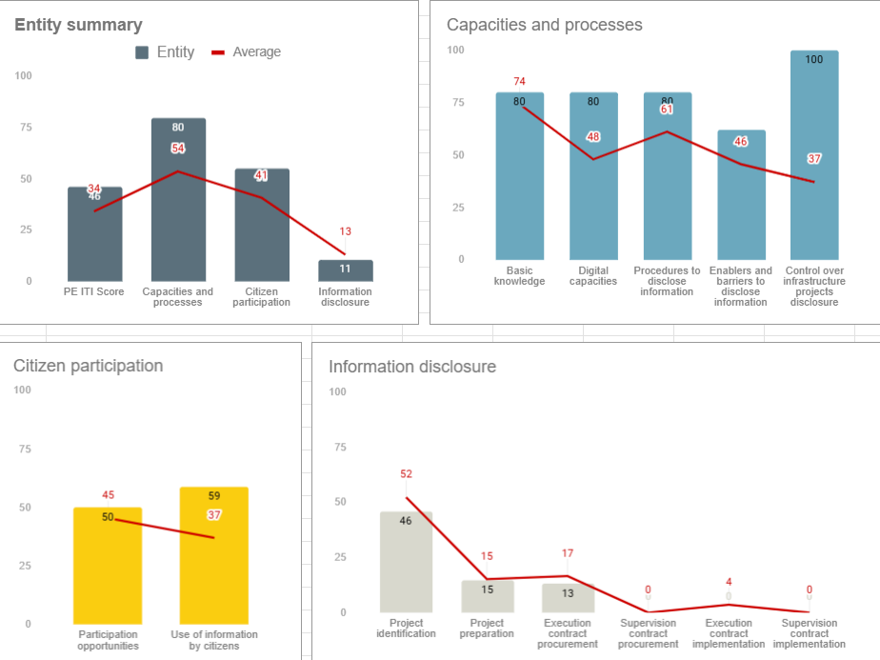
KADRA
Position 1

Slide 46
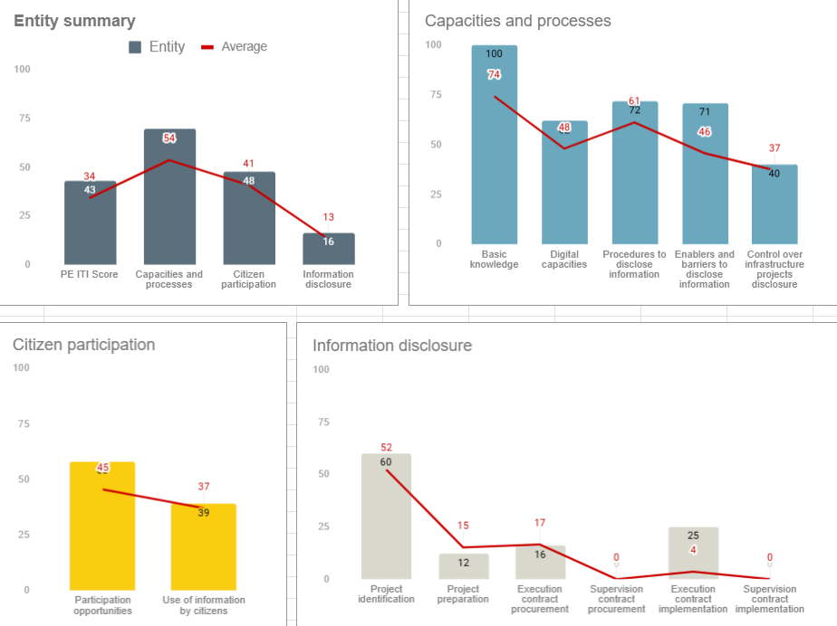
KADFAMA
Position 2

